Slide 1

New York City Taxi Data Analysis: January 2020
A comprehensive analysis of NYC yellow taxi trip data from January 2020, examining passenger counts, trip distances, fare amounts, and payment methods to uncover patterns and insights in urban transportation.

Slide 2
Data Overview and Preparation
Dataset Description
Data Cleaning
Key Variables
The analysis uses the NYC yellow taxi trip data from January 2020, containing over 2.7 million initial records with information on pickup/dropoff times, passenger counts, trip distances, payment types, and fare amounts.
We removed outliers using the Interquartile Range (IQR) method for fare amounts, trip distances, and trip durations, resulting in a cleaned dataset of approximately 2.3 million records for analysis.
Our analysis focuses on five main variables: passenger count, trip distance, payment type (Card vs. Cash), fare amount, and trip duration.

Slide 3
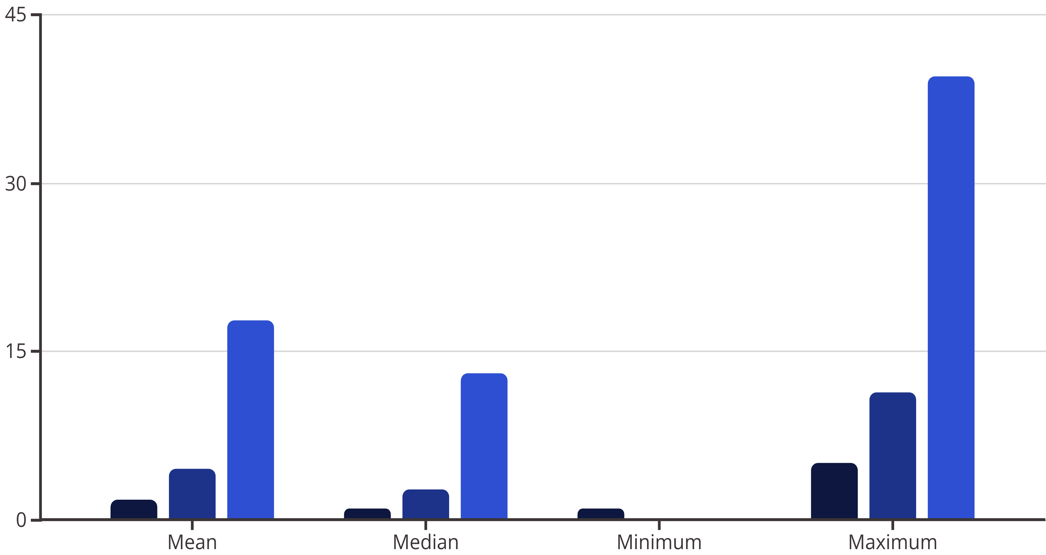
Descriptive Statistics
After cleaning the data, we examined the basic statistical properties of our key variables.
Passenger Count
Trip Distance (miles)
Fare Amount ($)
The data shows most taxi rides have just 1-2 passengers, with a wide range of trip distances and fare amounts. The difference between mean and median values indicates right-skewed distributions for all variables.

Slide 4
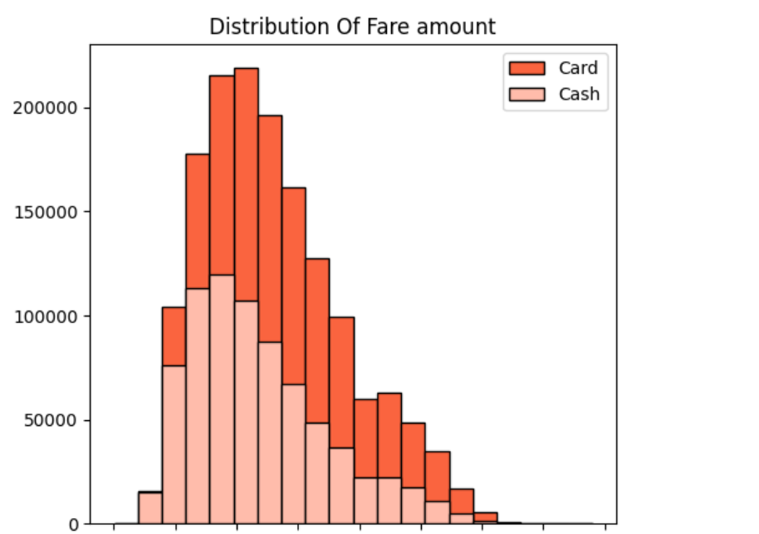
Distribution of Fare Amounts by Payment Type
The histogram reveals that fare amounts follow a right-skewed distribution for both card and cash payments. Most fares cluster between $5-$20, with card payments showing a slightly higher frequency across all fare ranges compared to cash payments.
This pattern suggests that passengers tend to use cards for both lower and higher-value rides, while cash usage decreases more rapidly as fare amounts increase.

Slide 5
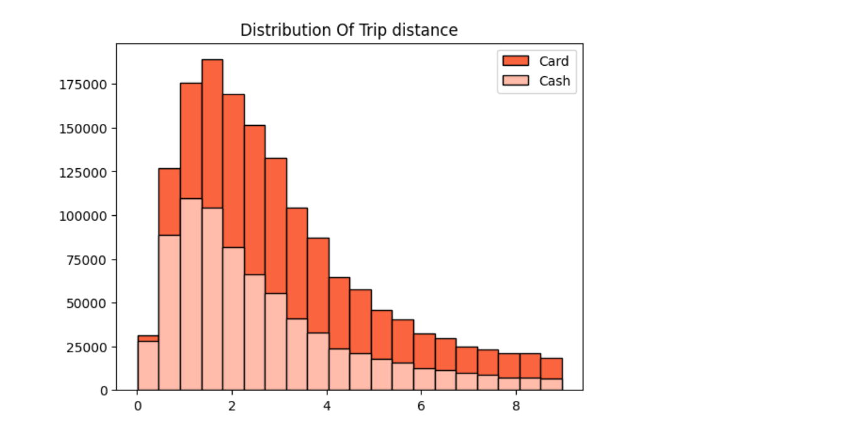
Distribution of Trip Distances by Payment Type
Similar to fare amounts, trip distances also follow a right-skewed distribution. The majority of trips fall within the 0-5 mile range, with a sharp decline in frequency as distance increases.
Card payments are more common across all distance ranges, but the preference for cards becomes even more pronounced for longer trips, suggesting travelers may prefer the convenience of card payments when taking longer journeys.

Slide 6
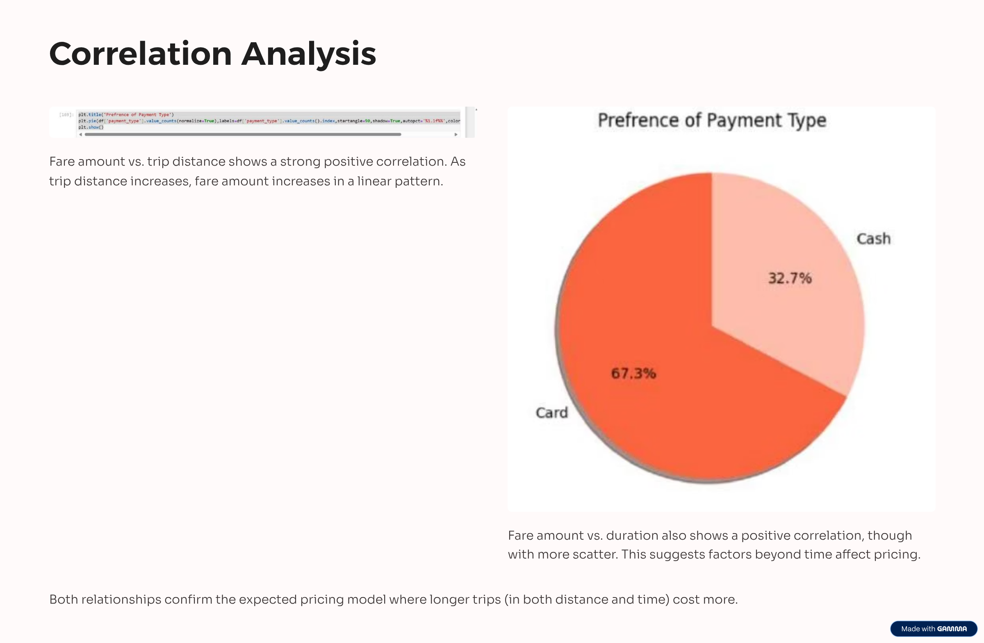

Slide 7
Payment Type Comparison: Mean Values
$13.11
$11.76
2.99
2.60
Card Payment Mean Fare
Cash Payment Mean Fare
Card Trip Distance (miles)
Cash Trip Distance (miles)
Standard deviation: $5.85
Standard deviation: $5.61
Standard deviation: 1.99
Standard deviation: 1.91
Card payments consistently show higher average values for both fare amounts and trip distances compared to cash payments. This suggests that passengers taking longer, more expensive trips tend to prefer card payments.

Slide 8
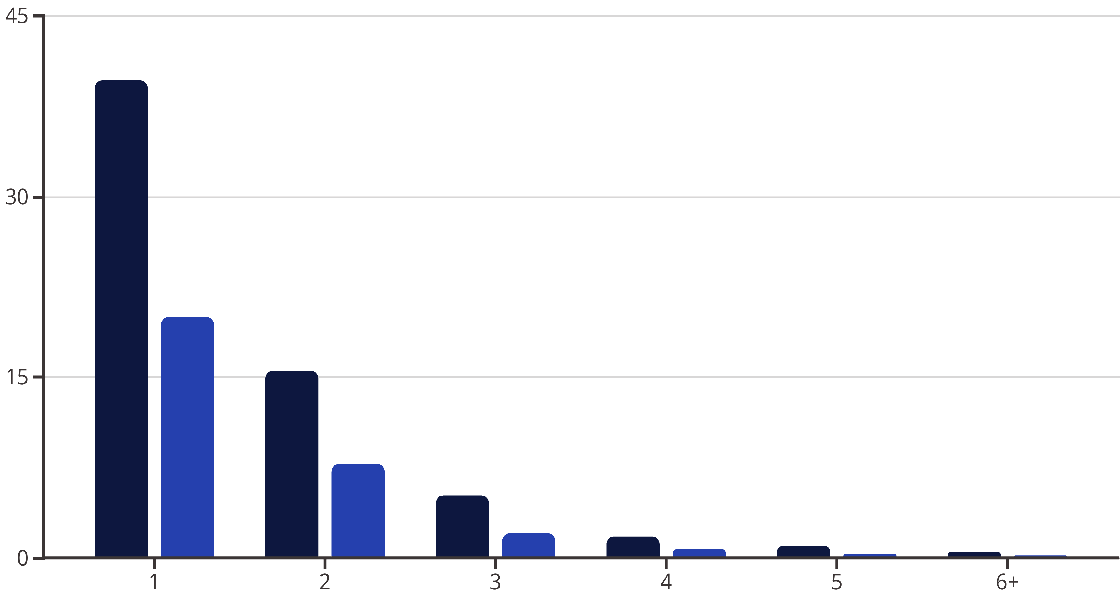
Passenger Count Distribution by Payment Type
Card Payment (%)
Cash Payment (%)
The chart clearly shows that single-passenger rides dominate NYC taxi trips, accounting for approximately 60% of all rides (39.6% card + 20.0% cash). Card payments are the preferred payment method across all passenger count categories.
The preference for card payments suggests a general trend towards cashless transactions for taxi services, regardless of the number of passengers.

Slide 9
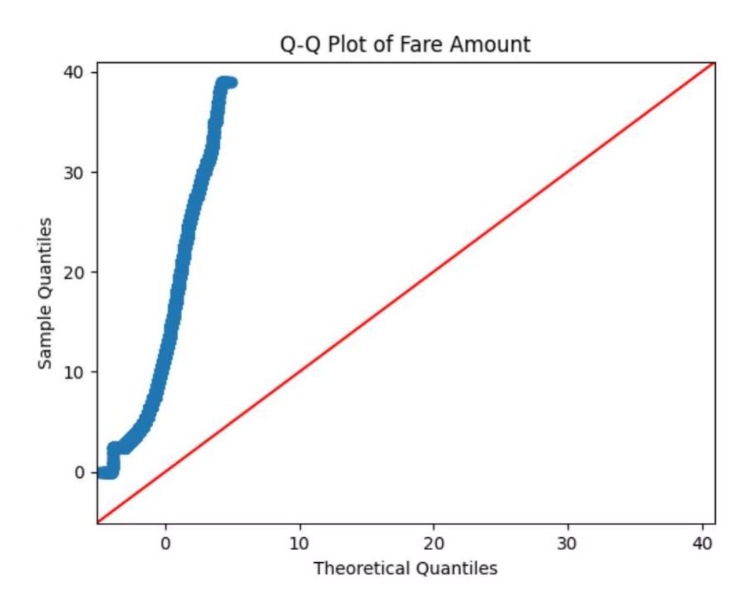
Statistical Testing: Fare Amount Normality
Before conducting comparative statistical tests, we examined whether fare amounts follow a normal distribution using a Q-Q plot.
The Q-Q plot shows significant deviation from the diagonal line, particularly at the tails, indicating that fare amounts do not follow a normal distribution. This non-normality is consistent with the right-skewed histograms observed earlier.
Despite this non-normality, the large sample size (2.3 million records) allows us to rely on the Central Limit Theorem for subsequent statistical testing.

Slide 10
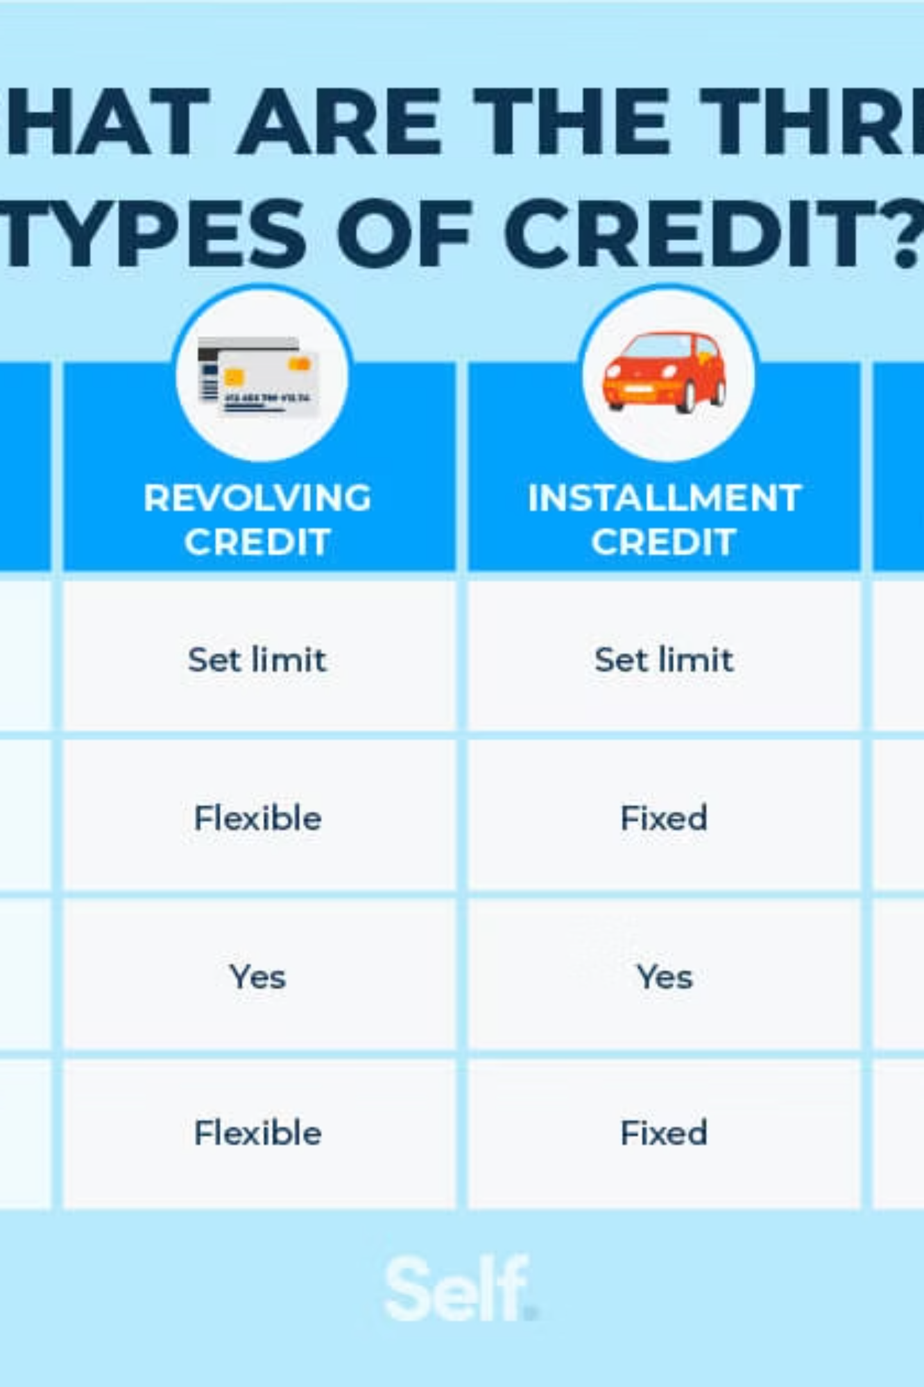
Card vs. Cash Payment: Statistical Comparison
T-Test Results
T-statistic: 169.81
p-value: 0.0
The extremely low p-value (effectively zero) indicates that the difference in fare amounts between card and cash payments is statistically significant.
Practical Significance
Card payments average $13.11 vs. $11.76 for cash payments, a difference of $1.35 or approximately 11.5% higher for card transactions.
This consistent pattern suggests systematic differences in how passengers choose payment methods based on fare amount.

Slide 11
Key Findings and Conclusions
1
Payment Preference
2
Fare and Distance Patterns
Card payments are consistently more popular than cash across all passenger counts and trip distances, with approximately 67% of all rides paid by card.
Card payments are associated with higher average fares ($13.11 vs. $11.76) and longer trip distances (2.99 miles vs. 2.60 miles) compared to cash payments.
3
Passenger Count Insights
4
Statistical Significance
Single-passenger rides dominate NYC taxi usage (approximately 60% of all rides), with card payments being the preferred method regardless of group size.
The difference in fare amounts between card and cash payments is statistically significant (p-value ≈ 0), confirming a genuine pattern rather than random variation.

